Slide 1
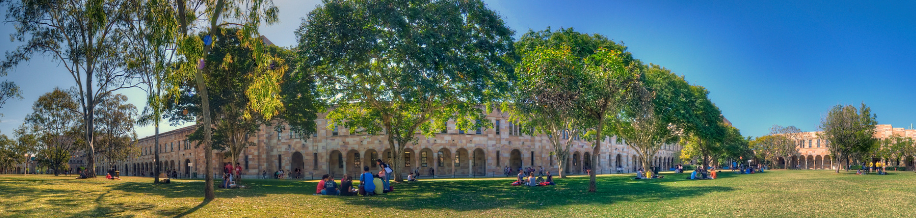
Automated, Corpus- and Usage-Based Semantic Classification of Word Class using Word Embeddings
Martin Schweinberger and Chang-Hao (Howard) Luo
The University of Queensland

Slide 2
Starting Point
Acknowledgement The study presented in this talk is based on Chang-Hao Luo’s MA thesis which I supervised and motivated at UQ.
Meaning obviously represents fundamental property of language and semantics impact all levels of linguistic analysis.
Including semantics in linguistic analyses is, however, hampered by the fact that the annotation of semantics is laborious, time-intensive, and often subjective.
This study aims to explore options that use a usage-based, automated method for annotating semantics so that meaning aspects are easier to integrate into linguistic analyses.

Slide 3
Overview of the study we present today
Aim
Develop a semantic classification system of adjectives using word embeddings
Motivation
Studies in LVC (e.g., Tagliamonte, 2007) suggest that the semantics of adjectives impact amplifier choice in ongoing language change scenarios
Outline
Background
Existing feature-based classifications
What are word embeddings, UMAP, and K-means clustering
Methodology: what we have done
Results and evaluation
Issues, Limitations and where from here?

Slide 4
Background

Slide 5
Background
Existing feature-based semantic classification systems
Typology-based classification (Dixon 1977) Aims to determine sematic features that underlie a universal, language-independent classification of semantic groups of adjectives based on syntactic and morphological properties of adjectives
Corpus/Distribution-based classification (Biber et al. 2007) Uses the Longman Spoken and Written English Corpus to extract frequencies of structure patterns in order to define grammatical properties of words, including using semantic features to group adjectives.
Automated, computational classification (USAS, distribution- and context-based) (Rayson, Archer & Piao, 2004) Uses the UCREL semantic analysis system (USAS) to automatically assign semantic tags based on a combination of part-of-speech (POS) tagging, a lemmatiser, and semantic tagging (Rayson, Archer & Piao, 2004)

Slide 6
Typology-based classification (Dixon 1977)
Dixon (1977) arrived at his classification of adjectives through a typological, comparative analysis of the semantic roles that adjectives typically fulfill across various languages.
Semantic classes
Dimension (size, length/width): big, little, long, wide, thin
Physical Property: denoting physical attributes: hard, light, smooth, sweet
Colour: red, blue, black, white
Human Propensity (emotions or personality traits): jealous, kind, dumb, happy, generous
Age: new, old, young
Value (denoting judgement): good, bad, proper, excellent, poor
Speed: fast, quick, slow

Slide 7
Corpus/Distribution-based classification (Biber et al. 2007)
Descriptors (denote physical features or characteristics)
Colour (denoting colour or brightness): black, white, dark, light
Size/weight (denoting size or weight): big, deep, heavy, tall
Time (denoting frequency or age): old, annual, late, new
Evaluative/emotive (denoting judgements and emotions): good, worse, lovely, poor
Miscellaneous descriptives (denoting physical or other properties): cold, complex, hard, private, strong
Classifiers (categorise in relation to modified noun)
Relational/classificational (delimits reference of nouns): additional, final, left, original, public
Affiliative (national or religious reference): American, Asian, Christian, Muslim
Topical (relation to a subject of area): commercial, industrial, mental, political

Slide 8
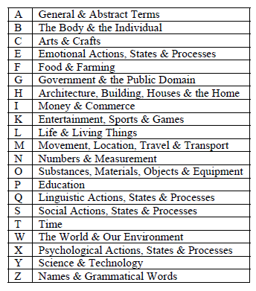
USAS (Rayson, Archer & Piao, 2004)
UCREL semantic analysis system
Originally developed by Paul Rayson for English.
Assigns words and multiword expressions to one of 21 semantic fields based on analyses of automatic translations as well as various resources such as lexical databases and thesuari.
It represents multilingual framework designed for the semantic analysis of text using corpus-based methods and it is notable for its ability to process large volumes of text data to extract and categorize semantic information.
The semantic tagset was based on Tom McArthur's Longman Lexicon of Contemporary English (1981).
It is a really great resource but not what we were looking for and the categories didn’t really fit our data well.

Slide 9
Issues of existing semantic classification systems
Time consuming Manual annotation of semantic classes are very time-intensive
Subjective Manual annotation can have low inter-rater reliability and show inconsistencies hindering reproducibility
Non-intuitive semantic categories/classes Automated annotation has high access/accuracy, is easy to implement, and produces replicable results but the semantic classes are not aligned with existing sematic classifications and did not work well for the adjectives we initially screened.
Our approach
We try to build on the manual semantic classification systems and use word embeddings as the basis of an alternative automated classification system that can be used by the research community

Slide 10
What are Word Embeddings?
Usage-based measure of semantic similarity (Chandrasekraran & Mago, 2021; Haripse et al., 2022)
Words with similar meaning have similar numeric vectors (because they occur in similar contexts) and would thus be displayed close to each other in two-dimensional space.
Word embeddings are a way to represent words as numerical vectors so that words with similar meanings are closer together in this numeric space. They are used in NLP to give computers a way to understand and process human language by capturing the relationships between words

Slide 11
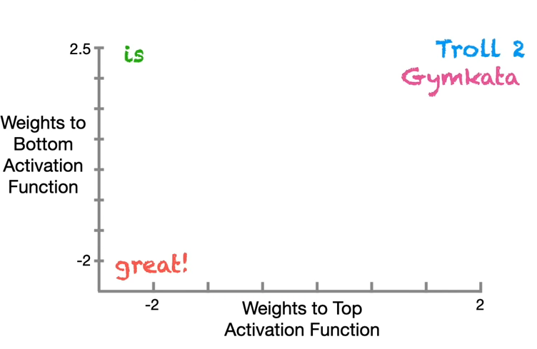
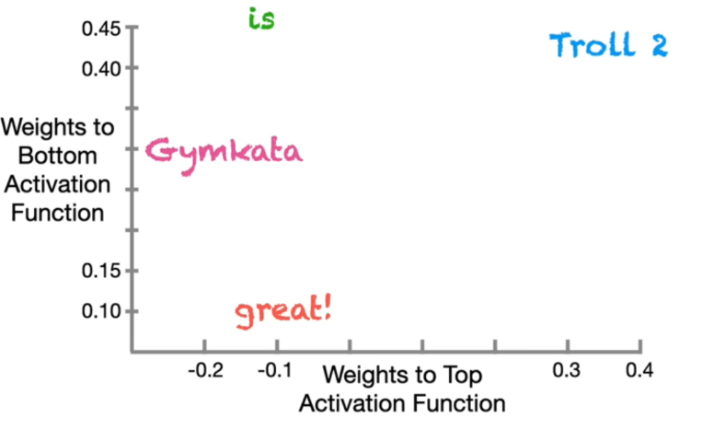
What are Word Embeddings?
Word embeddings are long vectors of numbers representing word types (or tokens).
Example:
cat (5, 7, 1, 0, 8)
dog (5, 8, 1, 0, 7)
table (1, 0, 8, 9, 2)
chair (1, 1, 7, 8, 2)
Example
Troll2 is great!
Gymkata is great!
Initially words are assigned a vector of random numbers. A random set of words is chosen: if words have the same context (surrounding words), their numbers are made more similar (over many iterations)
Source: StatQuest (2023)

Slide 12
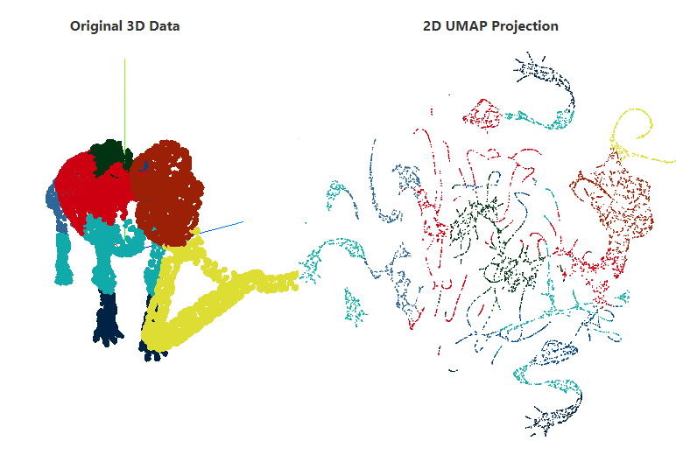
What is UMAP?
Uniform Manifold Approximation and Projection (UMAP) (see McInnes, Healy and Melville, 2020) is a statistical procedure used to reduce the number of dimensions from high-dimensional to low-dimensional data with minimal information loss.
The reduction of dimensionality renders complex data to be more readily analysable and visualizable.
It preserves both local and global structure of the data (groupings, distance, and patterns), helping to see relationships in a simpler, two-dimensional or three-dimensional space.
Source: Coenen & Pearce (2024)

Slide 13
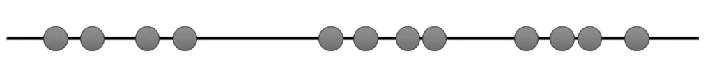
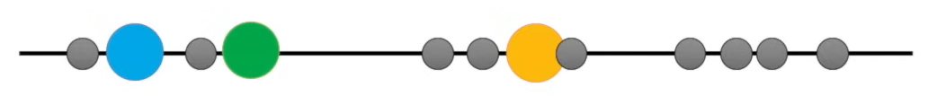
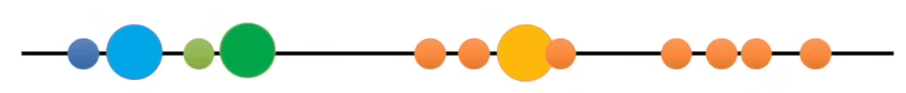
What is K-means Clustering?
Agglomerative clustering method (Franti, Virmajoki, & Hautamaki, 2006) used to identify what clusters elements belong to. The number of clusters (K) is set by the researcher. All elements are then assigned to the cluster they are closest to (closeness depends on what method is used).
Source: StatQuest (2018)

Slide 14
Data and Methodology

Slide 15
Methodology: what have we done?
Data
Pre-existing word embeddings (trained on news texts): Gigaword 5th edition corpus (Parker et al., 2011)
vocabulary size of 292,479 types (each with a vector of 300 dimensions)
generated using the Gensim Continuous Skip-gram algorithm
Processing
POS-tagging with UDPipe (Wiffels, 2021)
Extracted 4044 adjective types
Dimension reduction with UMAP (to reduce 300 to 2 dimensions)
UMAP: better at retaining both local and global structure during dimensionality reduction compared to similar methods (t-SNE)
Two methods:
perform UMAP after clustering (UA)
perform UMAP before clustering (UB)

Slide 16
Methodology: what have we done?
KNN Clustering
Checked different numbers of clusters (K): here we present the results for 8 and 12 clusters
Number of clusters: automated evaluations did not provide meaningful guidance
Number of clusters should be comparable to existing classifications (Dixon (1977) and Biber et al. (2007))
8 clusters did not produce a fine-grained enough solution
Evaluation
How did our results hold up against existing classifications (Biber et al. 2007)?
Eye-balling classification (manual checks)
Coherence metrics: How consistent were our results?
draw sample from each cluster to determine category type
generate new set of words based on category and check cluster allocation
generate Confusion Matrix and calculate coherence by comparing actual and predicted clustering

Slide 17
Methodology: what have we done?
Evaluation
Coherence metrics: How consistent were our results?
Cluster X | Feature
Red | Color
Blue | Color
Purple | Color
Salty | Misc.
Green | Color
Comparison | Cluster
Yellow | X
Aqua | X
Maroon | B
Teal | X
Violet | B
Color
Accuracy 3/5 = 60 %

Slide 18
Results and Evaluation

Slide 19
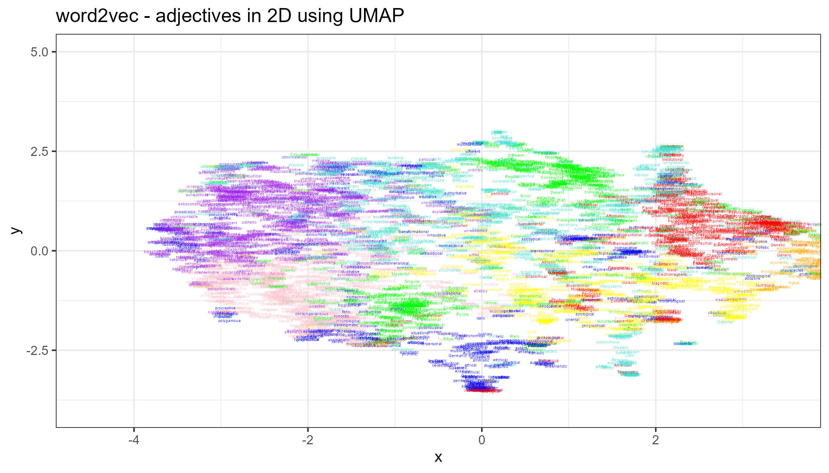
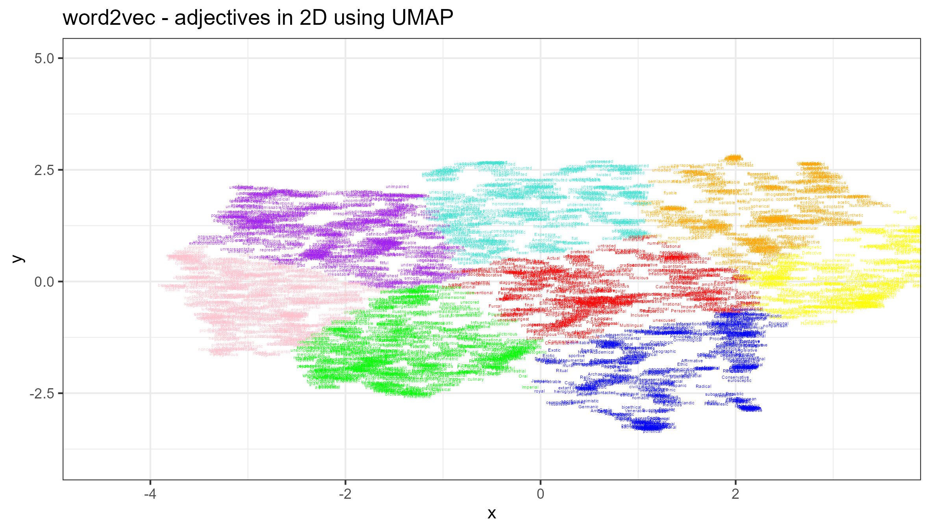
Clustering before and after Dimension Reduction
Results: UMAP before KNN (8K)
Results: UMAP after KNN (8K)
Average Consistency = 63%
Average Consistency = 67%

Slide 20
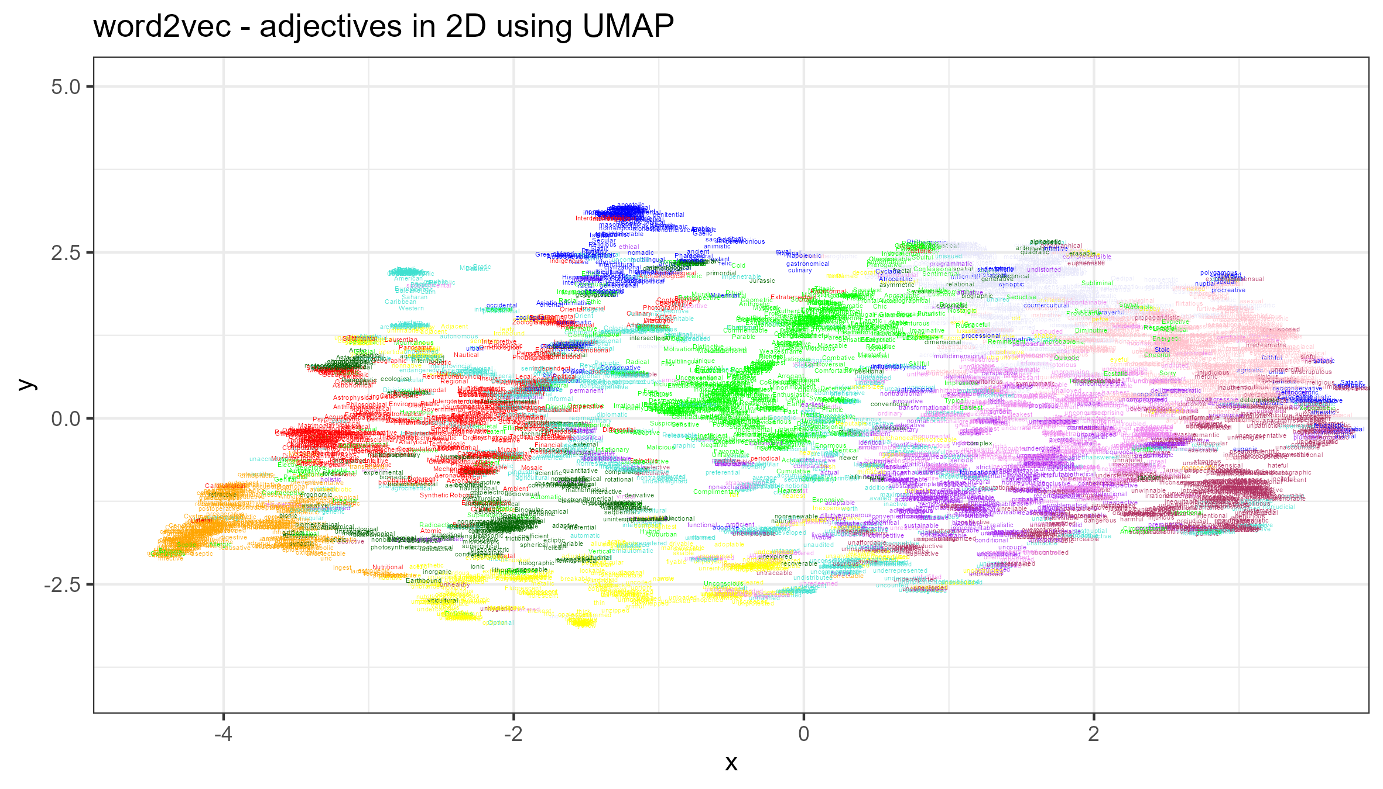
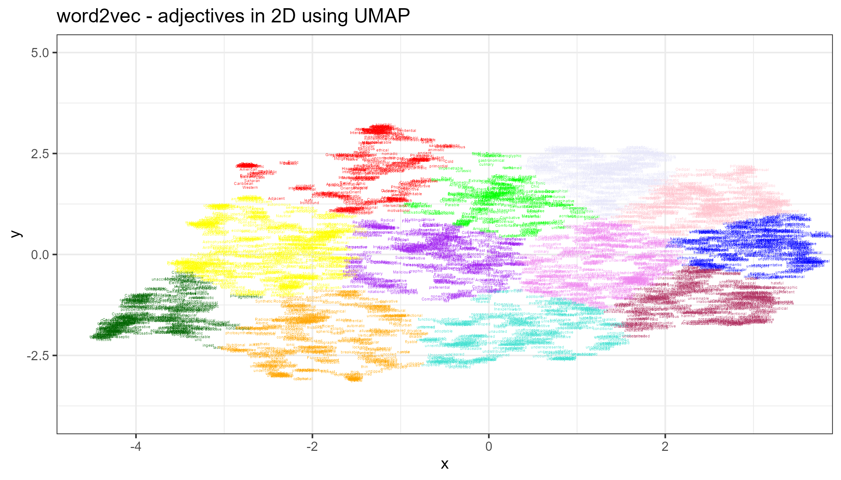
Clustering before and after Dimension Reduction
Results: UMAP before KNN (12K)
Results: UMAP after KNN (12K)
Average Consistency = 50%
Average Consistency = 52%

Slide 21
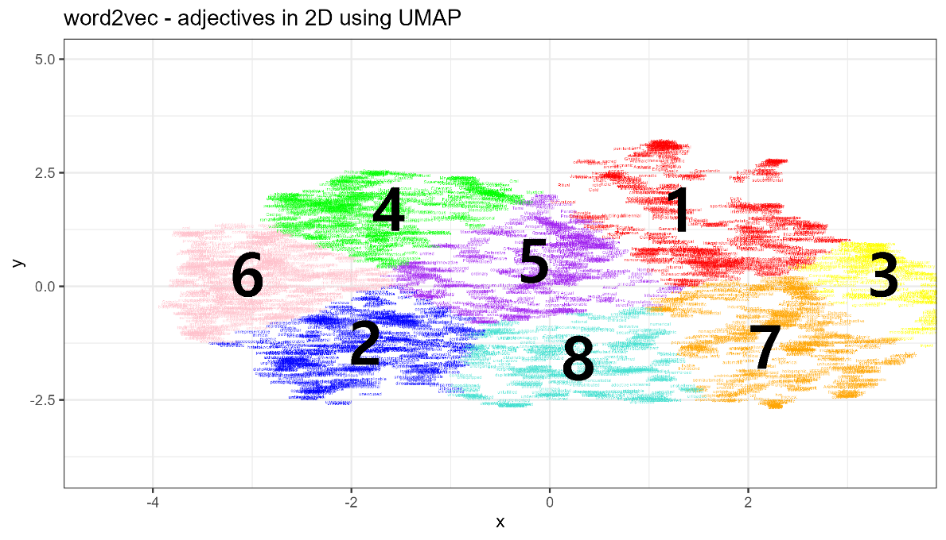
Clustering Solution (K8)
Id | Label | Example
1 | Affiliative (nation/state/region) | American, Japanese, Islamic
2 | Evaluative (judgemental) | hard, bad, possible, wrong
3 | Medical | mental, genetic, spinal
4 | Art/Genre related | popular, beautiful, romantic
5 | Descriptive (misc) | expensive, cheap, electronic
6 | Human traits | loyal, glad, faithful
7 | Domestic news-related | several, high, military
8 | Descriptives (non-human) | big, small, strong, largest
Average Consistency = 67%

Slide 22
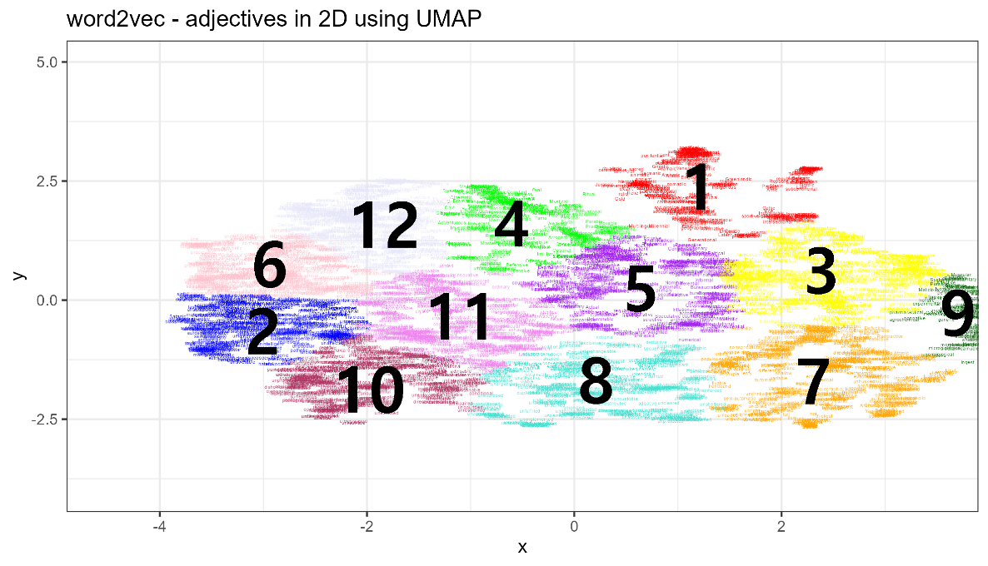
Clustering Solution (K12)
Id | Label | Example
1 | Affiliative (nation/ region) | American, Japanese, Islamic
2 | Neg. human trait | concerned, violent, angry
3 | Domains | industrial, public, academic
4 | Descriptive (biographic) | former, influential, youngest,
5 | Descriptive (news-related) | several, high, military
6 | Pos. human traits | funny, romantic, charismatic
7 | Descriptives (phy./ product) | expensive, cheap, electronic
8 | Descriptives (non-human) | close, dead, worth
9 | Medical | medical, mental, genetic
10 | Evaluative (sit.) | possible, difficult, criminal
11 | Evaluative(pos.) | good, best, strong
12 | Art/Genre-related | romantic, classical, epic
Average Consistency = 52%

Slide 23
Evaluation of Semantic Categories
Some were easily recognisable and had high accuracy, but other categories were difficult to categorise and lacked consistency.
Selected findings
Easy and accurate categorisation Medical (83% acc.): medical, physical, mental, fatal, clinical, spinal, surgical
Mixing (categories combining classes described in Biber et al., 2007) Relational and size (79% acc.): last, many, next , second, least, big, small, high, large
Over-generalisation Negative Evaluative (50% acc.): clear, bad, alleged, wrong, criminal, dangerous, worse, impossible, unclear
Uncategorisable Topical, Relational, Miscellaneous: Last, First, High, Special, Free, Cold, Best, Official, Heavy, Domestic
Category | Accuracy (%)
Affiliative + Topical | 33.3
Descriptive (phy.) | 75
Evaluative (neg.) | 50
Evaluative (pos.) | 43
Medical | 83
Relational + Affiliative | 95
Average | 63
Accuracy assessment: UMAP after DR (K8)

Slide 24
Methodology: what have we done?
KNN Clustering
Checked different numbers of clusters (K): here we present the results for 8 and 12 clusters
Number of clusters: automated evaluations did not provide meaningful guidance
Number of clusters should be comparable to existing classifications (Dixon (1977) and Biber et al. (2007))
8 clusters did not produce a fine-grained enough solution
Evaluation
How did our results hold up against existing classifications (Biber et al. 2007)?
Eye-balling classification (manual checks)
Coherence metrics: How consistent were our results?
draw sample from each cluster to determine category type
generate new set of words based on category and check cluster allocation
generate Confusion Matrix and calculate coherence by comparing actual and predicted clustering

Slide 25
Discussion Issues, Limitations, and Outlook

Slide 26
Discussion: Issues, Limitations and where from here?
What have we learned?
A semantic classification using usage-based data is possible, however there are still issues that require addressing:
Coherence: some clusters proved to be less coherent or distinctive as would be desirable
Polysemy: different senses of a type need to be addressed
PoS accuracy: the current study pos-tagging was inaccurate as we relied on a data set of pre-existing word embeddings trained on news texts
Word embeddings: we relied on a data set of pre-existing word embeddings trained on news texts
Evaluation: our metrics are somewhat crude, but we are unsure how to assess the quality of our method (aside from reproducibility)

Slide 27
Discussion: Issues, Limitations and where from here?
What can we do?
Compile data and self-generate word embeddings: we will generate our own word embeddings (using less but more diverse data) to avoid genre/text type bias and to allow the incorporation of polysemy (this will also dramatically improve pos accuracy)
Coherence: once we have generated custom word embeddings, we can adapt our approach and model parameters
optimizing K in KNN clustering
Number of neighbors in UMAP
Try alternative classifiers (which potentially improves coherence)
Evaluation: try out alternative evaluation methods (happy for input!)

Slide 28
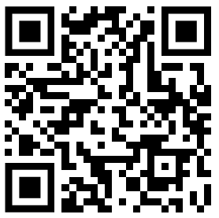
Thank you very much!
Contact
m.schweinberger@uq.edu.au
Slides and resources
https://github.com/MartinSchweinberger/ICAME45

Slide 29
References
Dixon, R.M.W. (1977). Where have all the adjectives gone?. Studies in Language, 1, 19-80.
Biber, D., Johansson, S., Leech, G., Conrad, S. & Finegan, E. (2007). Grammar of Spoken and Written English. Pearson Education Limited.
Chandrasekraran, D. & Mago, V. (2021). Evolution of Semantic Similarity – A Survey. ACM Computing Surveys, 51(2), Article 41. https://doi.org/10.1145/3440755
Coenen, A., & Pearce, A. (2024). Understanding UMAP. Google PAIR. Retrieved June 19, 2024, from https://pair-code.github.io/understanding-umap/
Haripse, S., Ranwez, S., Janaqi, S., Montmain, J. (2022). Semantic Similarity from Natural Language and Ontology Analysis. Springer Nature Switzerland AG
Hatrigan, J.A, Wong, M.A. (1979). Algorithm AS 136: A K-means clustering algorithm. Applied statistics, 28, 100-108. doi:10.2307/2346830.
McInnes, L., Healy, J. and Melville, J. (2020). UMAP: Uniform Manifold Approximation and Projection for Dimension Reduction. arXiv.org. https://doi.org/10.48550/arXiv.1802.03426
Parker, R., Graff, D., Kong, J., Chen, K., Maeda, K. (2011). English Gigaword Fifth Edition. https://doi.org/10.35111/wk4f-qt80

Slide 30
References
Starmer, J. (2023, March 13). Word Embedding and Word2Vec, Clearly Explain!!!. https://www.youtube.com/watch?v=viZrOnJclY0
Starmer, J. (2018, May 24). StatQuest: K-Means clustering. https://www.youtube.com/watch?v=viZrOnJclY0
Rayson, P., Archer, D. & Piao, S. (2004). The UCREL semantic analysis system. ResearchGate.
Tagliamonte, S. (2008). So different and pretty cool! Recycling intensifiers in Toronto, Canada. English Language and Linguistics, 12(2), 361-394. doi:10.1017/S1360674308002669
Wijffels, J. (2023). Udpipe: Tokenization, Parts of Speech Tagging, Lemmatization and Dependency Parsing with the ‘UDPipe NLP Toolkit. https://CRAN.R-project.org/package=udpipe.
Franti, P., Virmajoki, O., & Hautamaki, V. (2006). Fast agglomerative clustering using a k-nearest neighbor graph. IEEE transactions on pattern analysis and machine intelligence, 28(11), 1875-1881.

Slide 31
Automated, Corpus- and Usage-Based Semantic Classification of Word Class using Word Embeddings
Martin Schweinberger and Chang-Hao (Howard) Luo
The University of Queensland
Contact
m.schweinberger@uq.edu.au
Slides and resources
https://github.com/MartinSchweinberger/ICAME45

Slide 32


